Slide 2
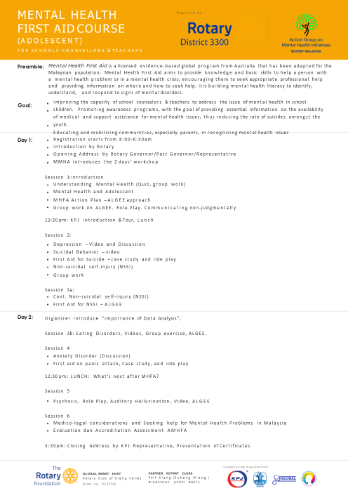

Slide 3
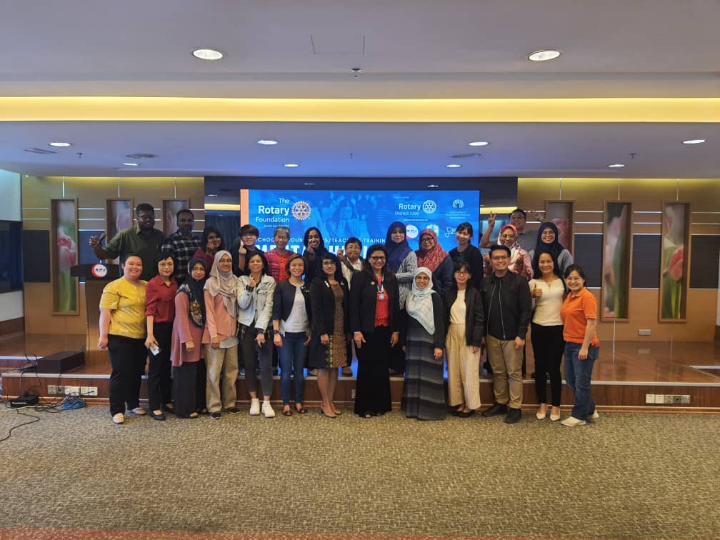
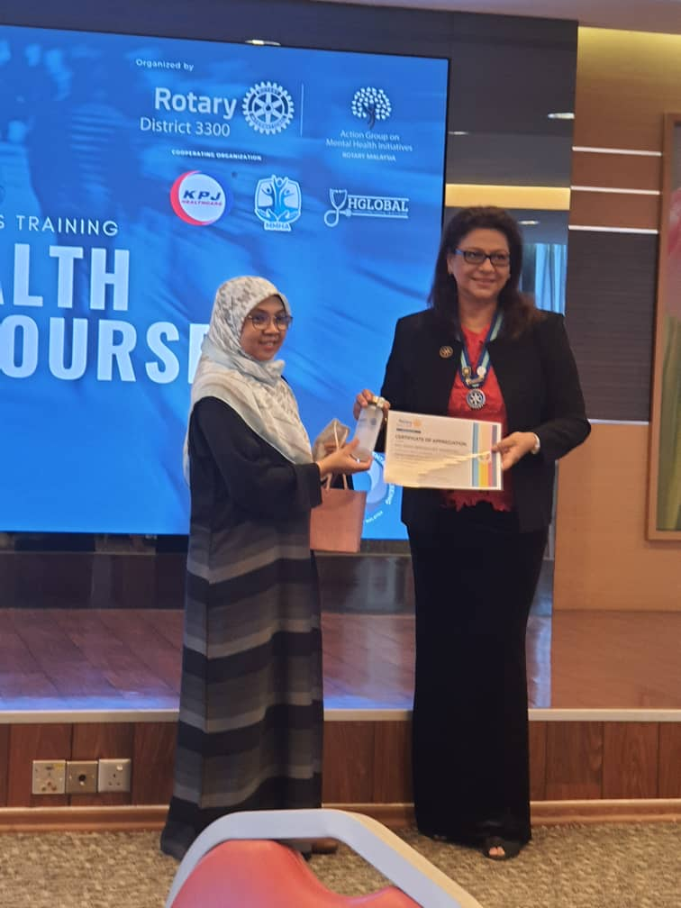
Program 1.0 KPJ Ipoh 30th & 31st Oct, 2022 20 participants MMHA Trainor Ms Jen

Slide 4
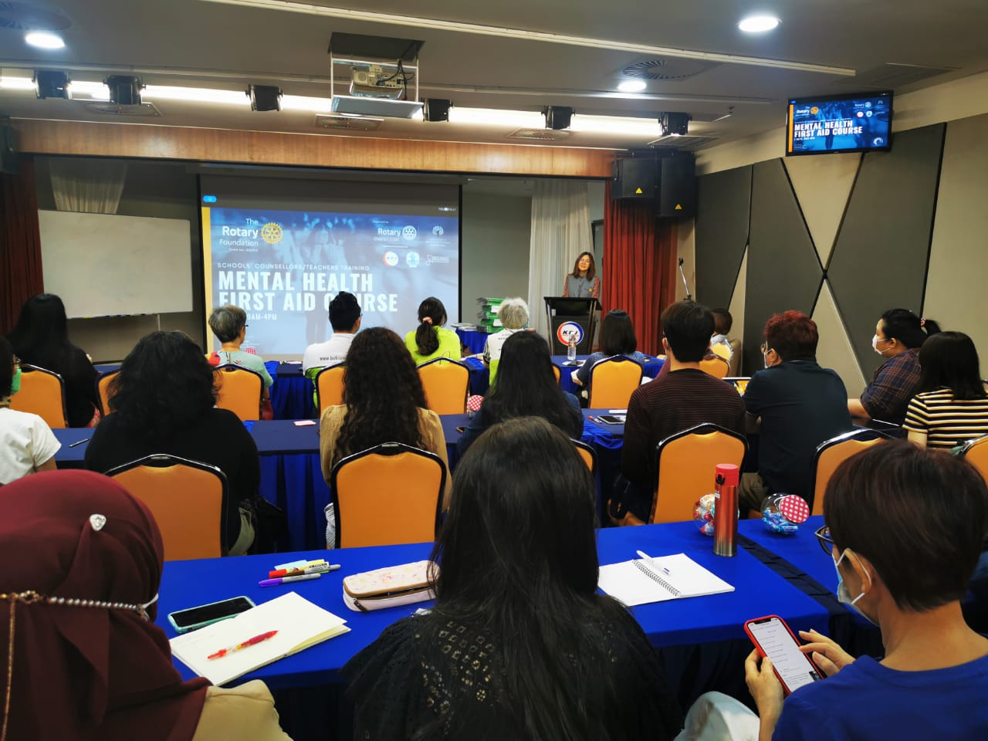
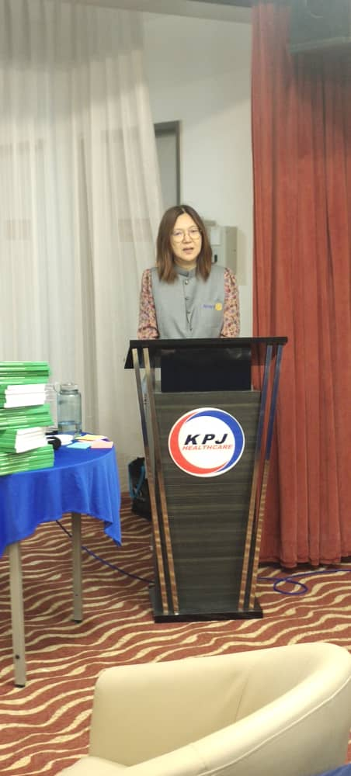
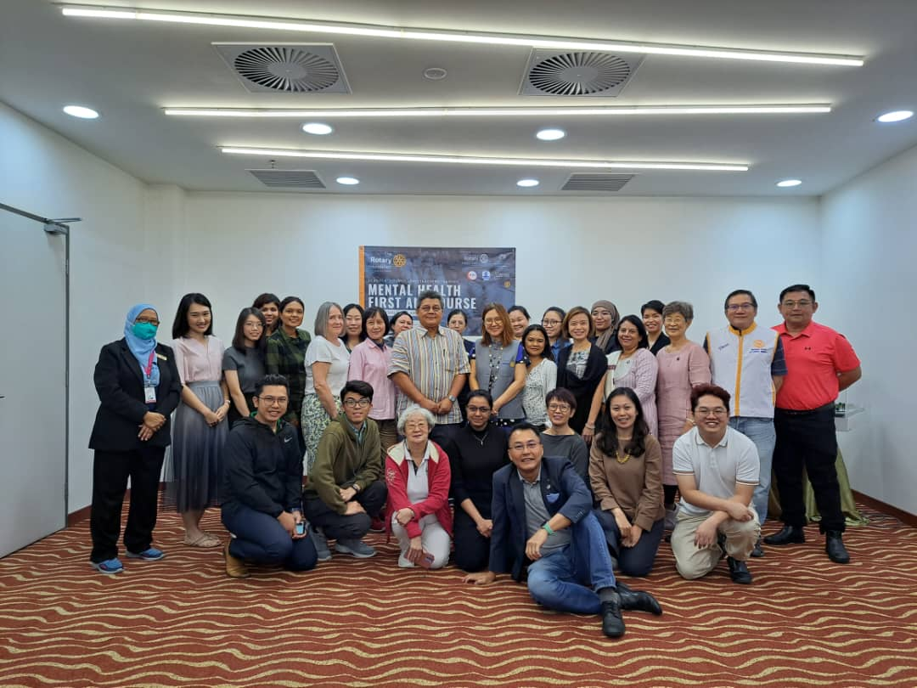
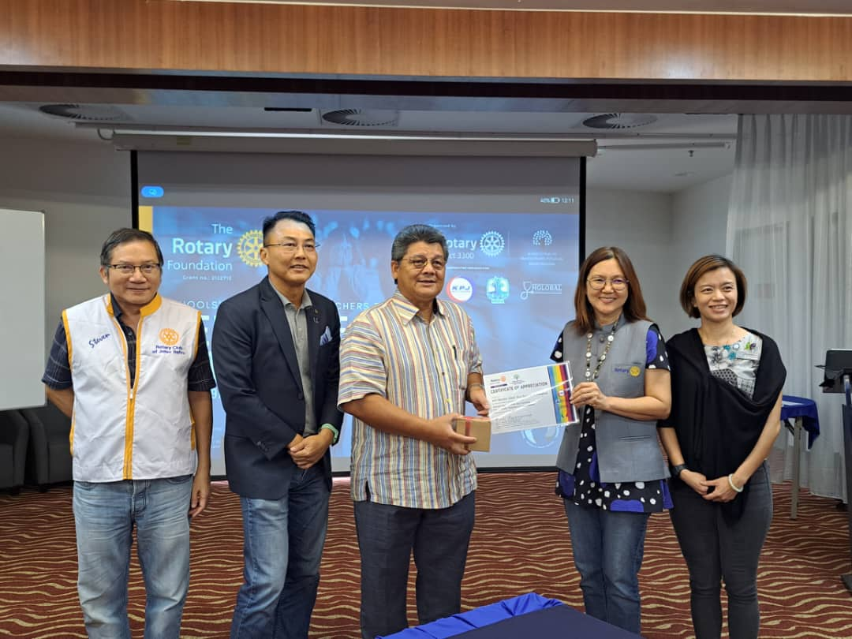
Program 2.0 KPJ Johor Bahru 5th & 6th Oct, 2022 25 participants MMHA Trainor Ms Jen

Slide 5
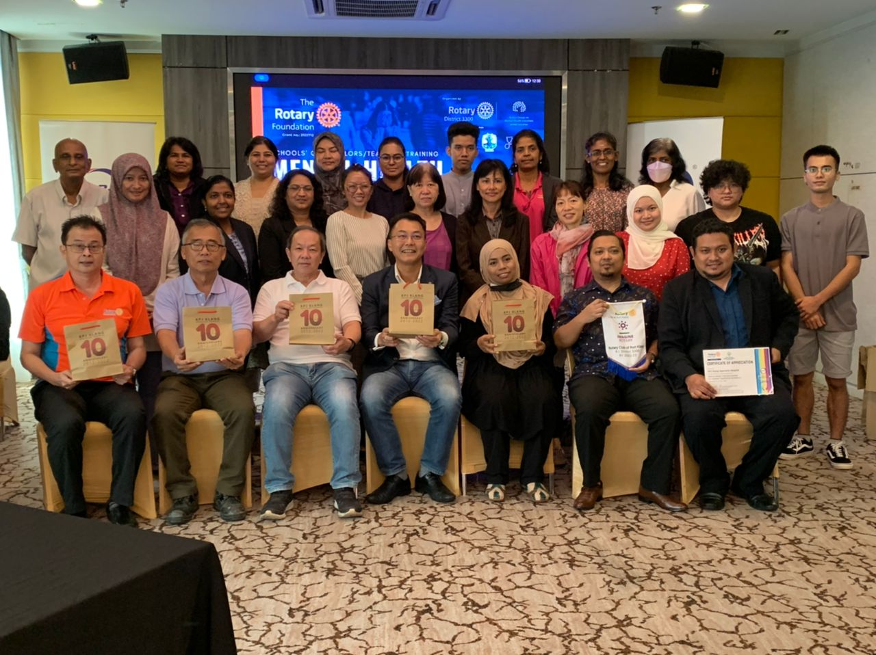
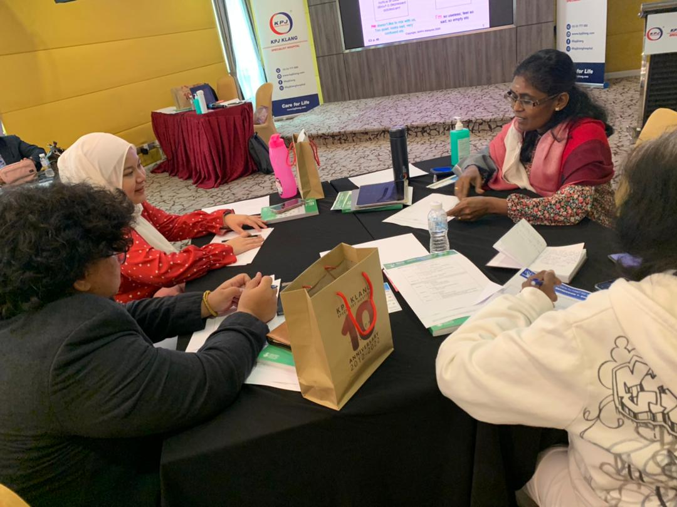
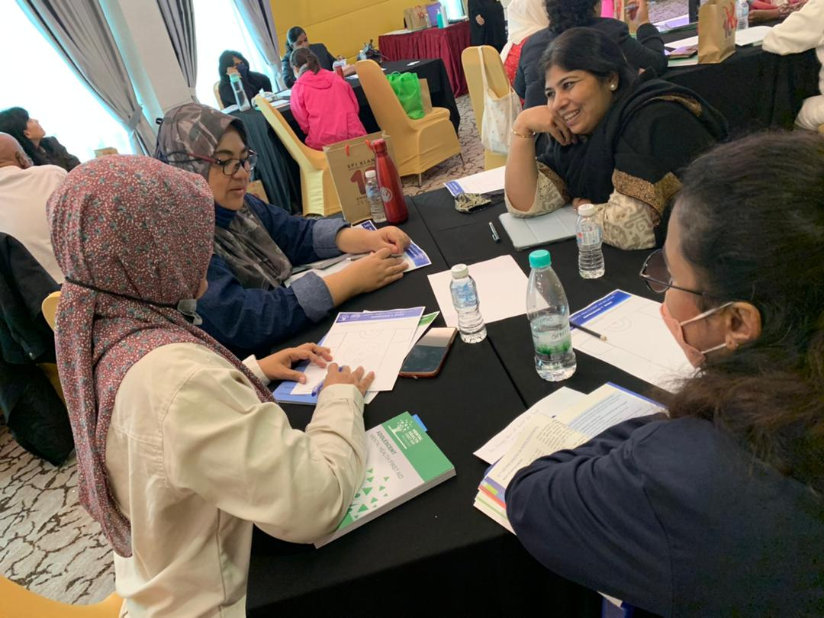
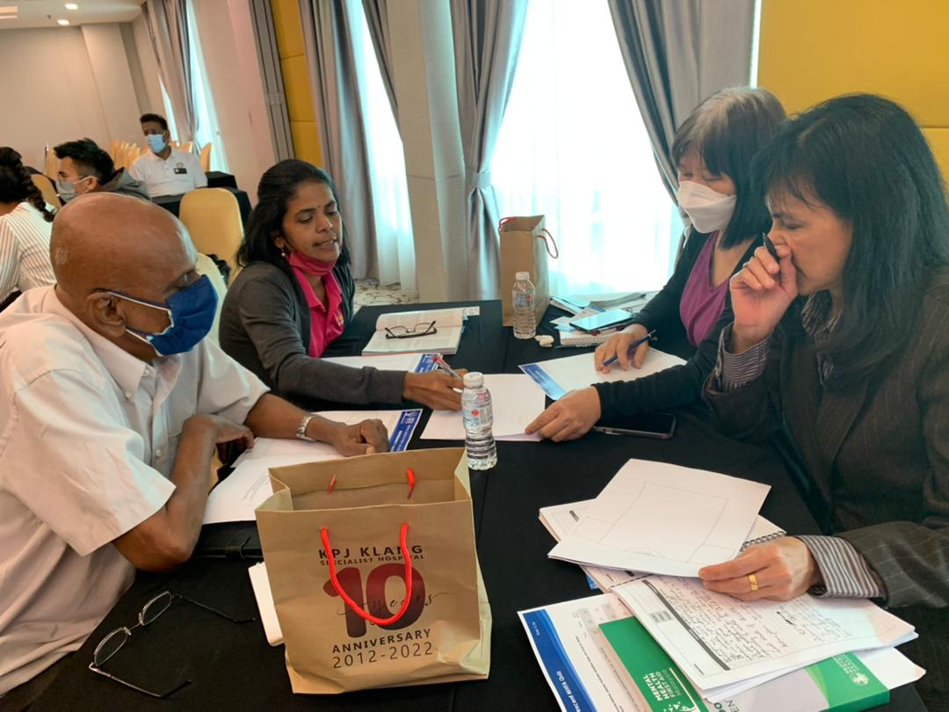
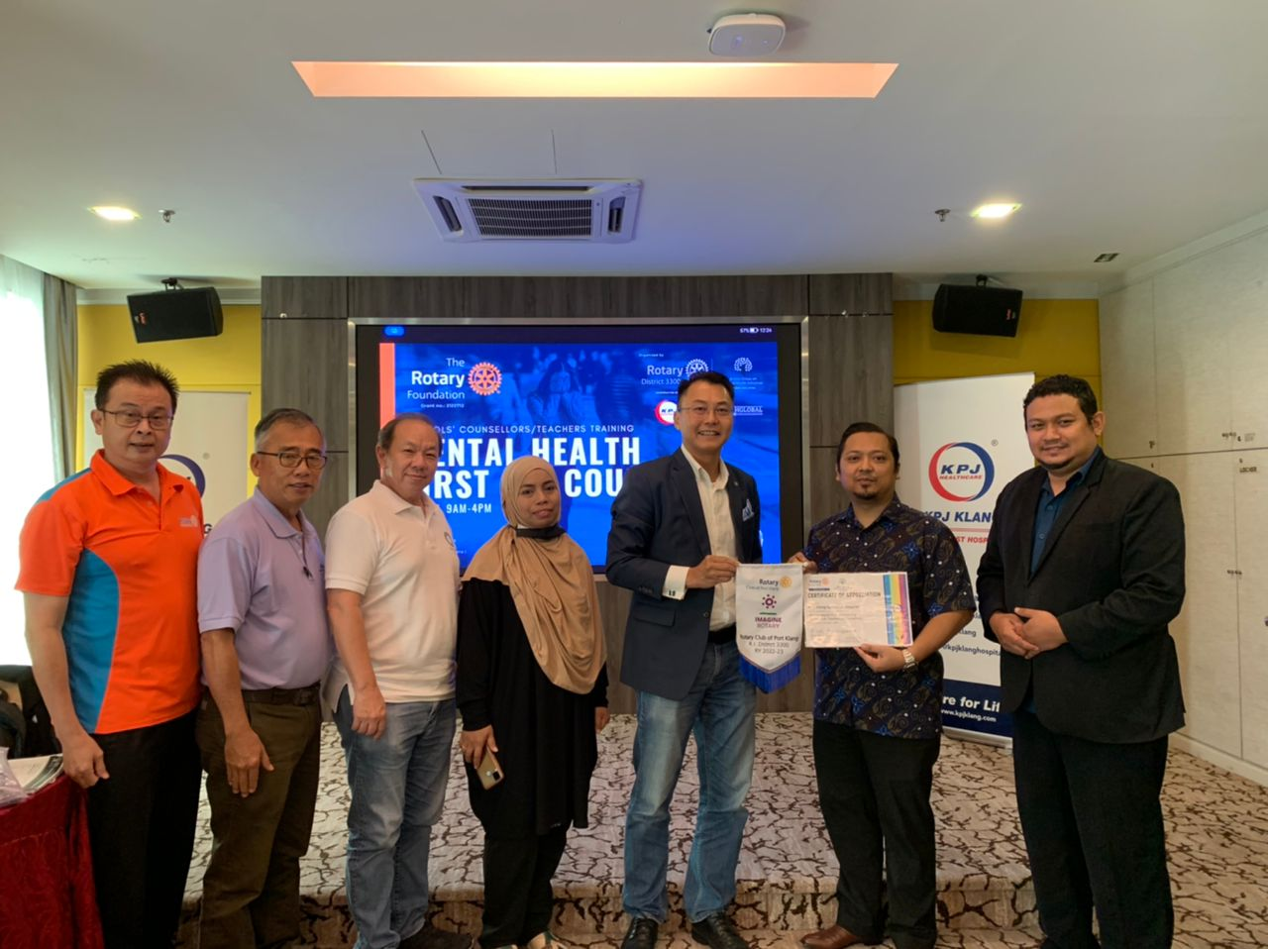
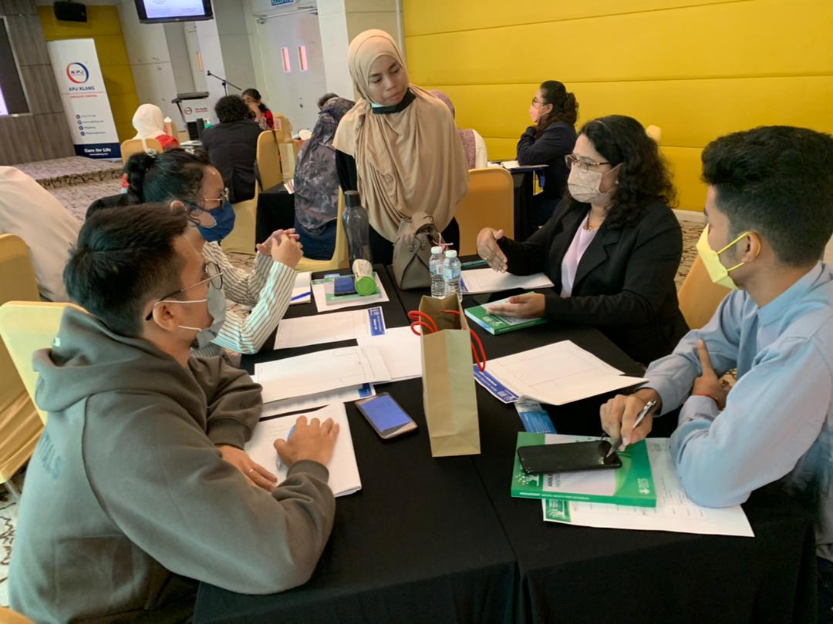
Program 3.0 KPJ Klang 12th & 13th Oct, 2022 Participants 19 MMHA Trainor Puan Nurhijjah

Slide 6
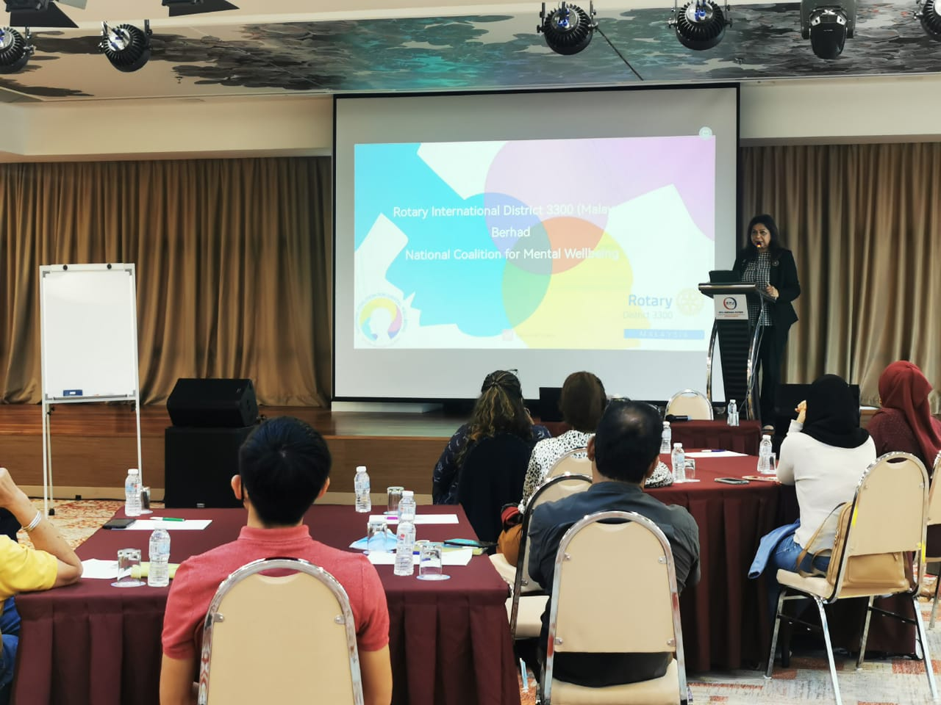
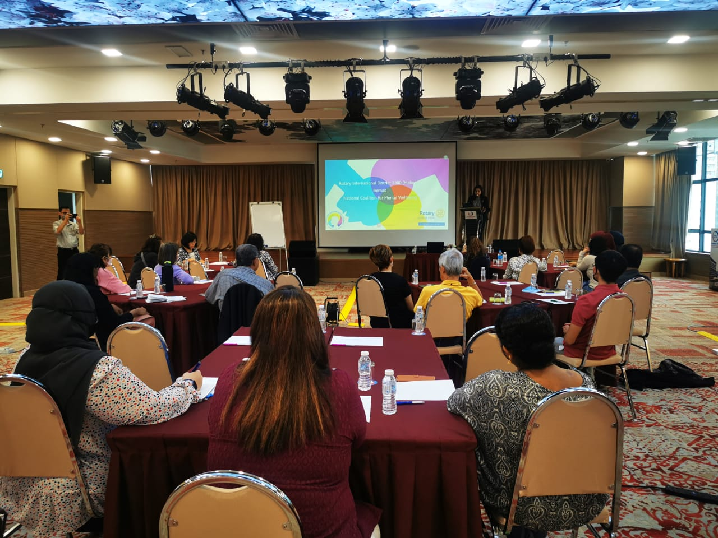
Program 4.0 KPJ Ampang Puteri,KL 26 & 27 Nov, 2022, Participants: 18 pax Trainor: Pn Fazlin Badri

Slide 7
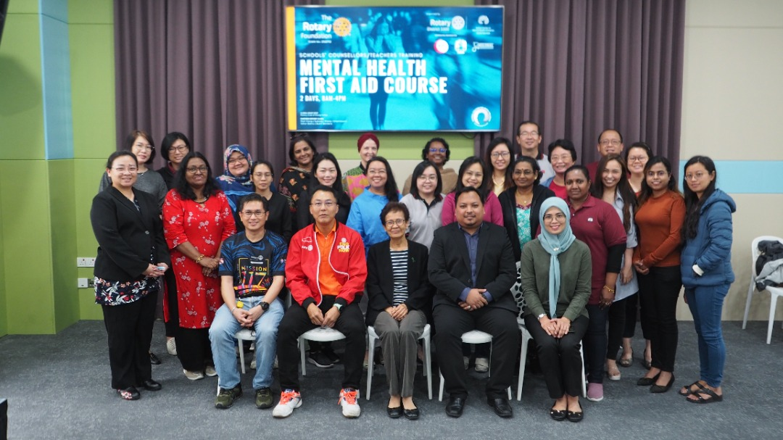
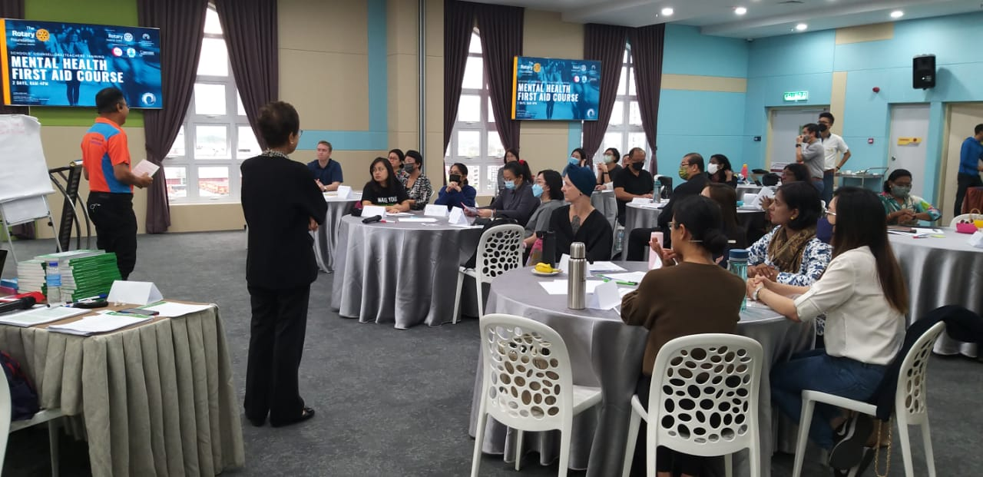
Program 5.0 KPJ Penang 7 & 8 Jan, 2023, Participants: 29 Trainor: Datin Ang

Slide 8
Summary Phase 1 Trained: 111 counselors & teachers Outreach: Over 200,000 school children Phase 2 (yet to be completed) To be trained : 200 counselors & Teachers Expected outreach: 500,000 school children

Slide 9
Mental Health Issues Identified During Mental Health First Aid from 1/7/22 to 21/3/23
Mental Health Issue | Depression | Anxiety | Psychosis | Eating Disorders | Suicidal | Stress | Others | Total
Number of Cases | 2 | 13 | 0 | 1 | 5 | 12 | 9 | 42
Mental Health Issues Identified During Mental Health First Aid from 1/7/22 to 21/3/23
13
14
12
12
10
No. of Cases
9
8
6
5
4
2
2
0
1
0
Depression Anxiety Psychosis
Eating Disorders
Suicidal
Stress
Others
Mental Health Issues
Mental Health Issues Identified During Mental Health First Aid from 1/7/22 to 21/3/23
Depression 5%
Others 21%
Anxiety 31%
Stress 29%
Psychosis 0%
Eating Disorders 2%
Suicidal 12%

