Slide 1
HASLINAH YACOB
LICENSED COUNSELLOR,
DIRECTOR OF SERVICES
ROTARY CLUB ALFA AMPANG

Slide 2
Activity 1: For a fulfilling life, what do you want and need?

Slide 3
Needs / Wants
Faith/Beliefs
Shelter
Relationships
Live
= HUMAN RIGHTS
Health
Recreation
Education
Employment

Slide 4
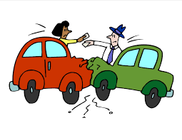
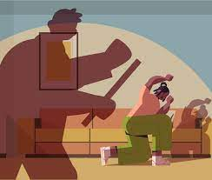
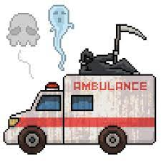
What is Trauma?
An emotional response to a terrible event (APA)
Acute
chronic
complex
vicarious

Slide 5
IMPACT OF TRAUMA

Slide 6
impact of traumatic events
Overstimulation of the Nervous System
Hyperarousal
fight-flight mode - anxiety, panic, anger, hyperactivity, and restlessness.
Self-regulate
Hypoarousal
depression, fatigue, dissociation, disconnection, “zoning out,” and lethargy.

Slide 7
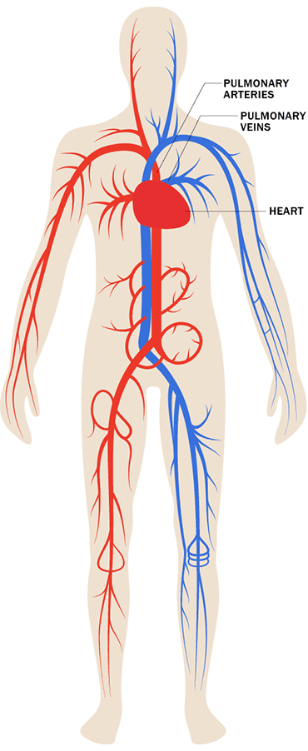
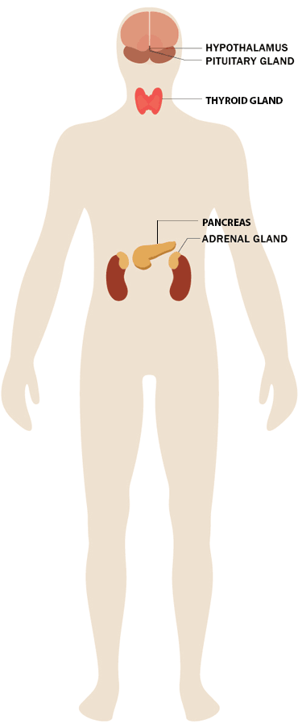
Cardiovascular System
Endocrine system
Run or Fight
- heartbeat increase, BP increase, heart attack
trigger endocrine and immune problems e.g. chronic autoimmune illnesses, heart attack, diabetes, stroke, and even cancer.
adrenaline, noradrenaline and cortisol

Slide 8
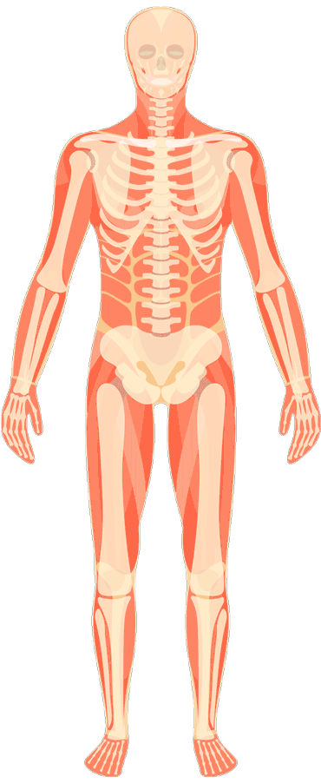
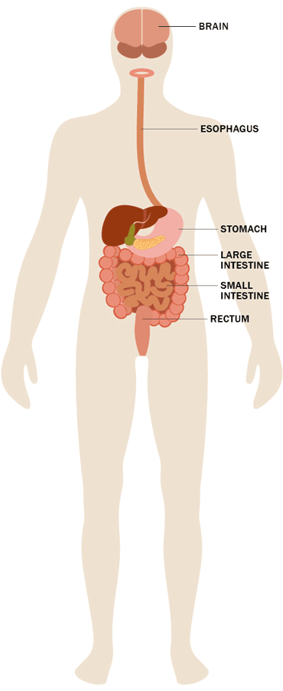
gastrointestinal
Musculoskeletal
Tensed muscles
Migraine
Back pain
Brain – stomach communication :
“Butterflies in tummy”
Stomache
Bloating
Chamges in Gut bacteria Acid Reflux

Slide 9
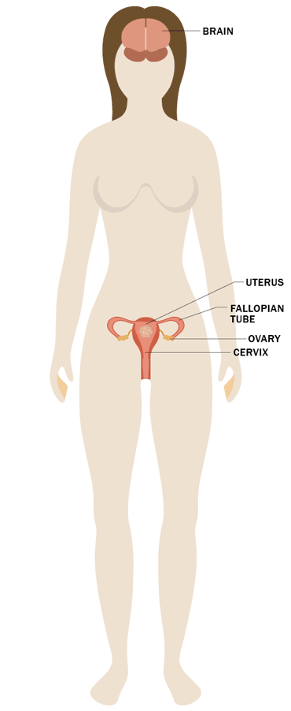
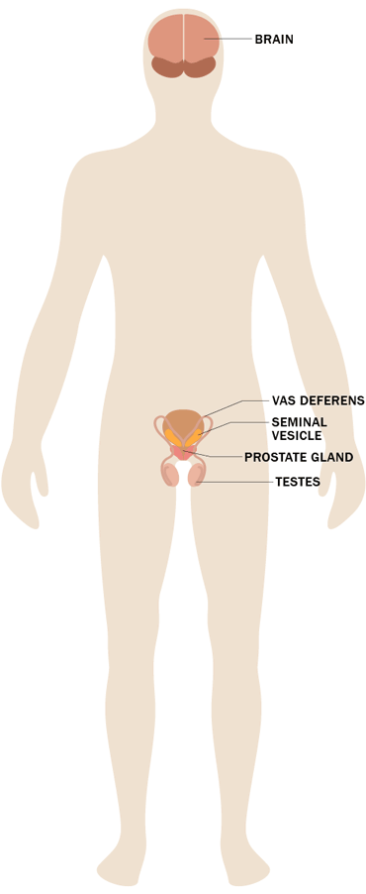
Reproductive Health
Lower libido, erectile dysfunction, infertility, maternal stress, STD

Slide 10
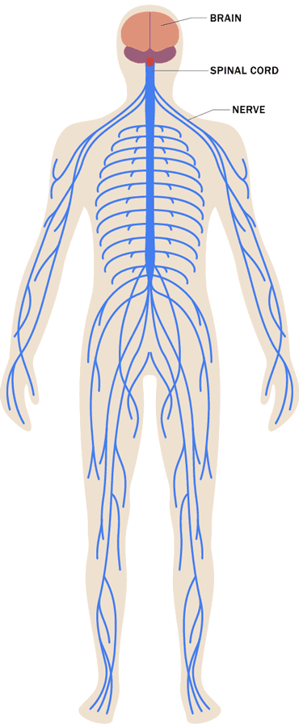
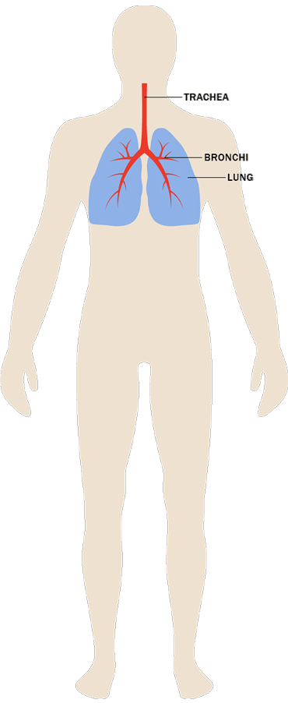
Respiratory
System
Nervous System
Neurological Dysfunction : hypervigilance, anxiety, and flashbacks
Difficulty breathing

Slide 11
Self-destructive behaviors
- drinking too much, driving too fast, self-harm
Changes in sleeping habits.
Trouble concentrating.
Irritability, angry outbursts or aggressive behavior
Depression, anxiety, flashbacks,
Stonewalling

Slide 12
Depersonalization
Detached from yourself.
Derealization
world around you isn’t real.
Motor Vehicle Accidents 112 patients PTSD 7.4% (Malays Fam Physician. 2017; 12(3): 2–7)

Slide 13
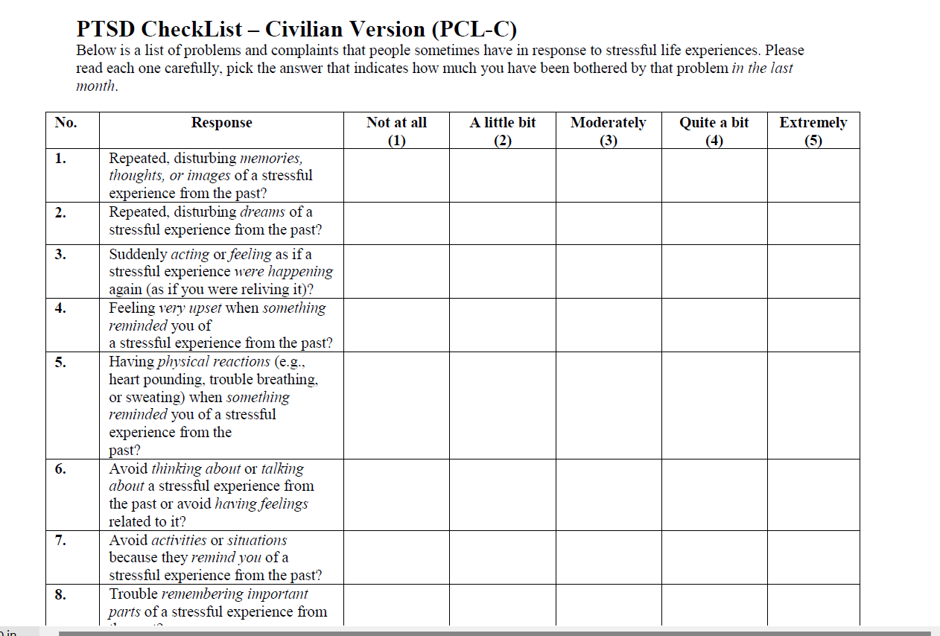

Slide 14
Overcoming Trauma

Slide 15
“negativity bias” - the capacity to pay attention to negative experiences in order to protect ourselves from harm

Slide 16
Change Perspective : Life = Good + Bad +
Mundane.

Slide 19
THE Memory
memory records are fragmented and disorganized (examples)
Dissociative amnesia : you may forget or block out a memory from the incident (examples)
sensory details, emotions,
and physiological reactions
Context; facts
(Triggers) Hot Memory
Integrated Memory
Cold Memory

Slide 20
Let’s practise

Slide 21
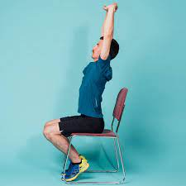
Grounding - reducing hyperarousal
1. Deep Breathing
2. Stretching
3. Distract
4. Let the thoughts flow

Slide 22
WRITTEN Narrative Exposure Therapy
repeated exposure to trauma-related memories allows habituation and eventually extinction to take place over time, leading to reduced anxiety in response to trauma-related stimuli
Step 1 : client writes about one specific trauma event in great detail,
where & when the event happened
(chunk every 5 mins, then ground 2 mins)
Step 2 : describe feelings, thoughts and sensations that were experienced during the event.
Step 2 : Stop when you reach “Safe Place”

Slide 23
THANK YOU!
Remember
YOU deserve happiness

